Slide 1
Leverage

Slide 2
Current news
https://bfsi.economictimes.indiatimes.com/news/banking/dont-classify-accounts-as-default-if-repayment-within-10-days-banks-ask-rbi/95190360

Slide 3
Industry cases
https://www.moneycontrol.com/stocks/marketinfo/debt/bse/index.html

Slide 4
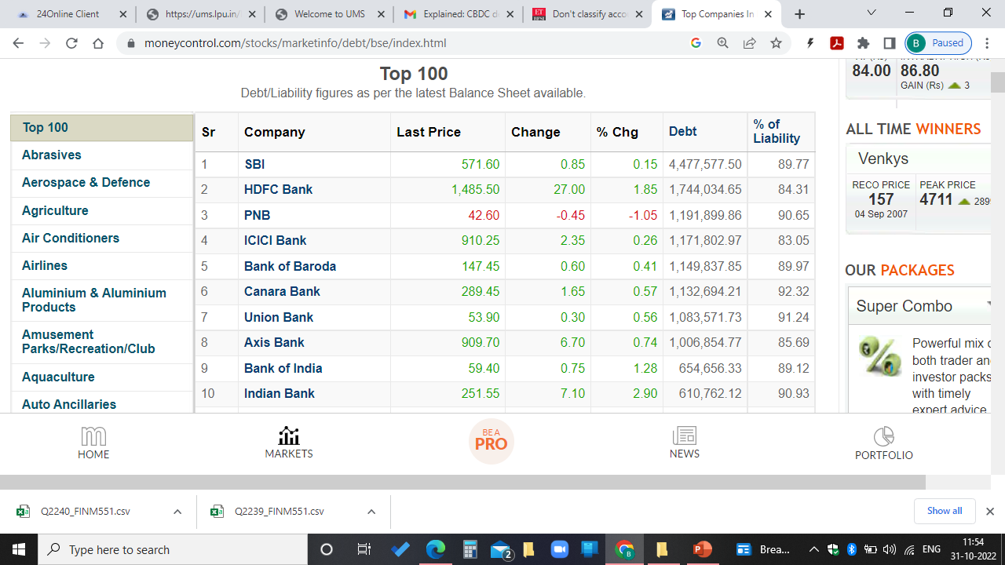

Slide 5
Learning outcomes
Relate the type of sources of finance in a proper combination
Explore right combination of sources of finance
Analyse the best combination

Slide 6
Leverage
According to James Horne, leverage is, "the employment of an asset or fund for which the firm pays a fixed cost or fixed return".
Leverage refers to debt or to the borrowing of funds to finance the purchase of a company's assets.
Business proprietors can use either debt or equity to finance or buy the company's assets.
Use of debt, or leverage, increases the company's risk of bankruptcy. It also upsurges the company's returns, specifically its return on equity.

Slide 7
Types of leverage
Operating Leverage
Financial leverage
Combined or Composite Leverage

Slide 8
Types of leverage- 1.Operating leverage
It measures the extent of the fixed operating costs of a firm.
If the operating leverage of a firm is high, it implies that it has high fixed costs in comparison to a firm with a low operating leverage.
It measures the effect of change in sales on the level of EBIT.
Degree of operating leverage (DOL) refers to a firm‟s ability to use fixed operating costs to magnify effects of changes in sales on its earnings before interest and taxes.

Slide 9

Cont…
Formula
Degree of Operating Leverage (DOL) =Contribution / Operating profit
Or = Sales- variable Cost / EBIT
where
Contribution = Sales- variable Cost
Operating profit= Sales- variable Cost –Fixed Cost
** An operating Leverage of 1.5 means that an increase in sales by 1% would cause the operating profit to increase by 1.5%

Slide 10
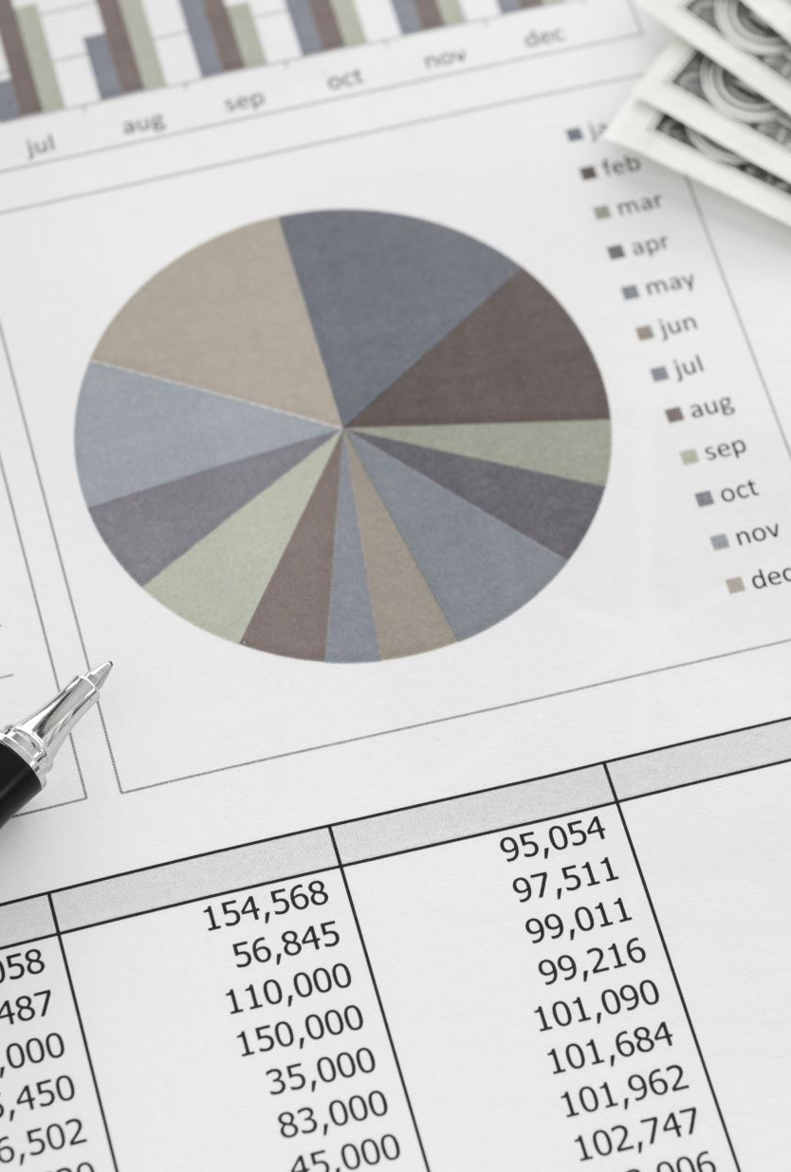
Cont…
Fixed cost
Break even point = -----------------
P/V Ratio
Contribution
P/V Ratio = ----------------------
Sales
Percentage change in profits
Degree of Operating Leverage (DOL) = ---------------------------------------
Percentage change in Sales
*** If a firm does not have fixed cost, then there will be no operating leverage.

Slide 11
Problem solving
Find the DOL if a firm's sales is Rs.10 lakh, Variable cost is Rs.7Lakh, Fixed cost is Rs. 2Lakh, 10% Debt of Rs.5Lakh. Also comment on the operating leverage position of the company?

Slide 12
MCQs
Degree of Operating Leverage (DOL) =
Sales-variable cost / Operating profit
Sales-Variable cost-Fixed cost / Operating profit
Sales-Variable cost-Fixed cost-Interest / Operating profit
Sales-Variable cost-Fixed cost-Interest-Tax / Operating profit

Slide 13
MCQs
Degree of Operating Leverage (DOL) =
Sales-variable cost / Operating profit
Sales-Variable cost-Fixed cost / Operating profit
Sales-Variable cost-Fixed cost-Interest / Operating profit
Sales-Variable cost-Fixed cost-Interest-Tax / Operating profit

Slide 14

MCQ
There will be no operating leverage if a firm does not have
Variable cost
Fixed cost
Interest
Tax

Slide 15
MCQ
There will be no operating leverage if a firm does not have
Variable cost
Fixed cost
Interest
Tax

Slide 16
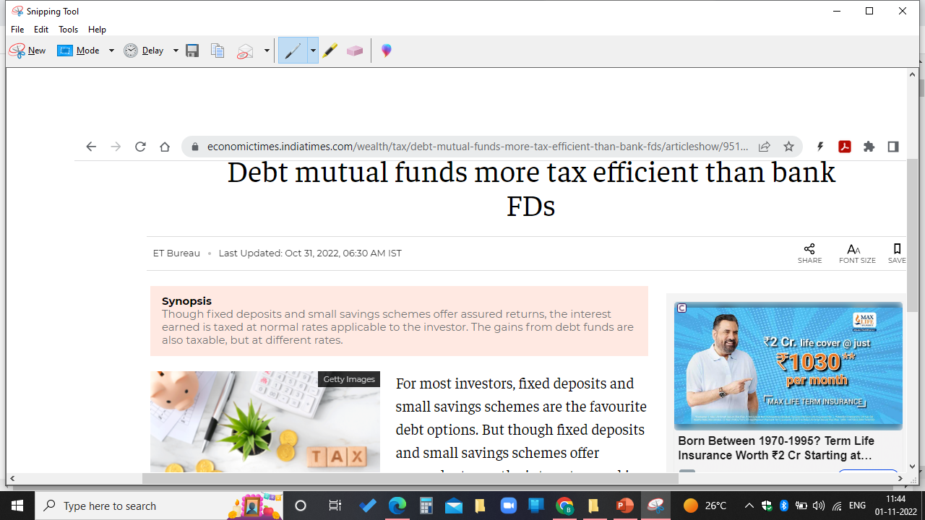
News Analysis

Slide 17
Types of leverage- 2. Financial Leverage
The ability of a firm to use fixed financial charges to magnify the effect of changes in EBIT/Operating profits, on the levels of EPS is knows as Financial Leverage.
It measures the extent to which the fixed financing costs arise out of the use of debt capital
A firm with high financial leverage will have relatively high fixed financing costs.

Slide 18
Types of leverage- 2. Financial Leverage
Formula
Degree of Financial Leverage (DFL) = % Change in EPS / % Change in EBIT
(OR)
= EBIT/ EBT
Where EBIT= Sales-Variable cost-Fixed cost, EBT= (Sales-Variable cost-Fixed cost)-Interest

Slide 19

Problem solving
Find the DFL if a firm's sales is Rs.10 lakh, Variable cost is Rs.7Lakh, Fixed cost is Rs. 2Lakh, 10% Debt of Rs.5Lakh. Also comment on the financial leverage position of the company?

Slide 20

Types of leverage- 3. Combined or Composite Leverage
It measures the effect of percentage change in sales on the percentage change in EPS. It indicates the effect that change in sales has on EPS. It helps to maintain a proper balance between operating profit and sales without exposing the firm to too much risk.
Formula: Degree of Combined Leverage
(DCL) = Operating Leverage*Financial Leverage

Slide 21
Live industry exposure
https://mintgenie.livemint.com/news/markets/top-10-companies-in-india-with-lowest-debt-to-equity-ratio-should-you-invest-151654500983949
https://www.screener.in/screens/180258/debt-to-equity-ratio-of-10000cr-companies/

